Slide 1
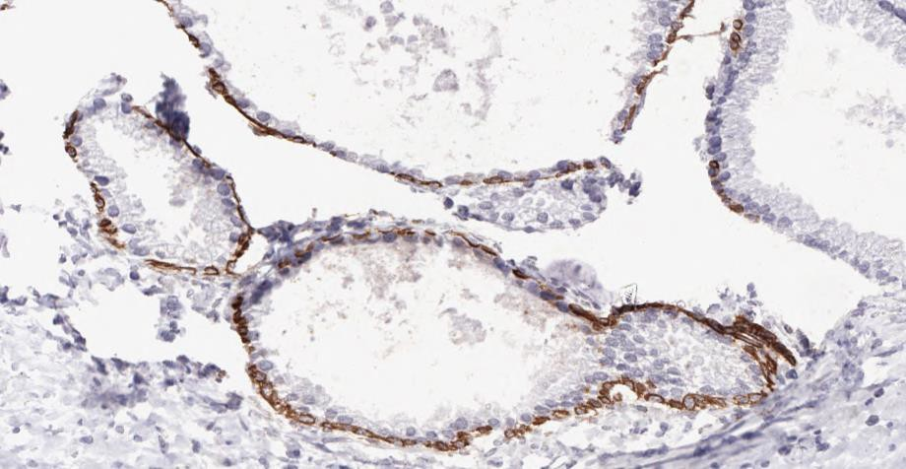
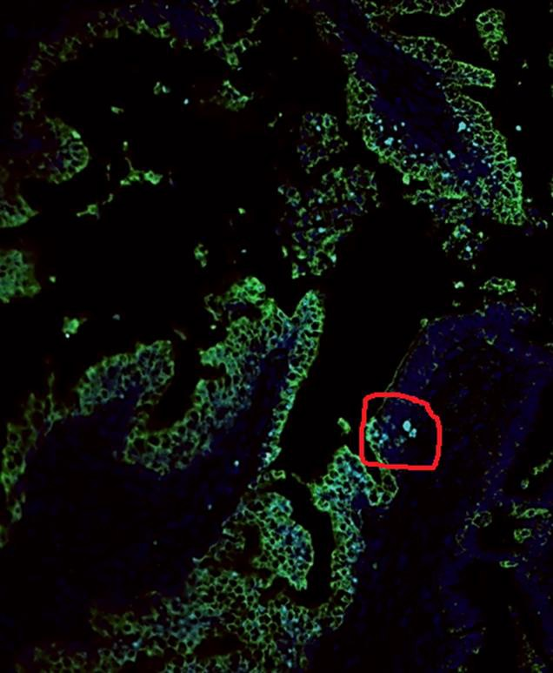
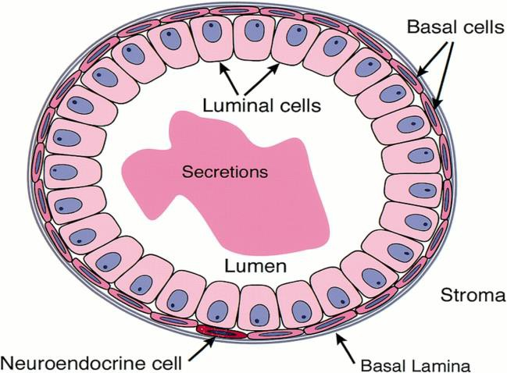
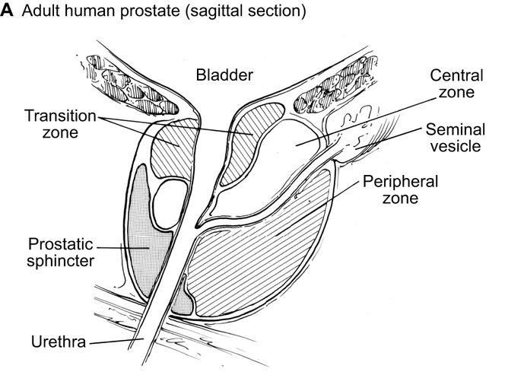
Identification of Prostate Stem Cell Niche and its role in carcinogenesis
Zhen Xin Wong | Z.X.Wong3@Newcastle.edu.my | MBBS Stage 2 | 160657850 Supervised by : Dr Sesha Subramanian and Prof Rakesh Heer
Background
The prostate gland is an important male reproductive organ which is responsible for the production of semen. A stem cell niche is a microenvironment surrounding stem cells which regulates their activity to maintain the normal cell cycle. Hence, dysregulation of the stem cell niche can lead to unstoppable division which contributes to the formation of cancer. . Kuffel like factor-4 (KLF4) is protein that is highly expressed in non-dividing cells and its overexpression induces cell cycle arrest. KLF4 is important in preventing cell division when DNA is damaged which may be used as marker to predict cancer. Microscopically, prostate gland consists of basal cells, luminal cells and neuroendocrine cells as shown in image 1. It has been proposed that stem cells are more prevalent in basal cell layers which can give rise to new basal and luminal cells. Macroscopically, stem cell niche is hypothesised to be located in the proximal location of prostate gland instead of distal. Distal Proximal Image 1 _{Image 2}
Result
IHC optimization Opal kit method 34Beta312 markers are used with optimal The image above show prostate tissue undergone concentration of 1:100. The cytoplasm of basal cells Opal method with few markers—PSA shown as bright are stained clearly . green, uroplakin shown as dark green, KLF shown as aqua blue. The circle area is the junction between prostate and ureter which is the proposed area for stem cell niche.
Aim
To identify the location of prostate stem cell niche Investigate the relationship between KLF-4 and prostate stem cell niche
Discussion
The boundary between urothelium and prostate gland are identified in where stem cell niche is proposed to be present. This is confirmed with the DLK-1 marker which stains proliferative cells and the circle area is shown to contain the most DLK-1 marker compared to other areas. (Image is not shown for this as this part of work is done by Dr Sesha) The aqua blue area shown in the circle (stem cell niche) indicates the reaction between cells with the KLF marker. Since the KLF4 marker is important in preventing cell division when the DNA is damaged, its regulation is important in preventing carcinogenesis. The relationship between the KLF marker and stem cell niche of prostate cancer warrants further study.
Method
Immunohistochemistry (IHC) Optimisation . Slides containing prostate gland will undergo four processes which are dehydration, blocking of nonspecific site to prevent unnecessary binding, addition of primary antibodies and lastly dehydration and mounting. All the process are the same except the addition of primary antibodies as different primary antibodies stain for different parts in different cells. Slides are then viewed under the microscope.
Marker | Optimal Concentration * | Stained area
34 BetaE12 | 1:100 | Cytoplasm of basal cell
PSA | 1:5000 | Cytoplasm of luminal cell
KLF | 1:50000 | Nucleus of luminal cell
Uroplakin | 1:20 | Urothelium
p63 | 1:100 | Nucleus of basal cell
Androgen receptor | 1:500 | Nucleus of luminal cell
Ki67 | 1:100 | Proliferative cell
Chart 1 showing optimal concentration for each marker and the area that the marker mainly stained. For optimal concentration, 1:100 means 1µL of primary antibody dissolved in 100µL of solvent Optimal concentration for all the markers are developed through serial dilution for the primary antibodies. For example, for the marker PSA, different concentrations for primary antibodies are used (1:2000, 1:3000, 1:5000, 1:7000) and the optimal concentration is determined based on the images under the microscope. The four highlighted marker are then repeated on prostate tissues using another method known as Opal method. It allows for the staining of tissues using multiple primary antibodies (which cannot be performed on IHC procedure as one marker is allow on one slide in IHC procedure).
Result
Stem cell niche is present at the boundary of urothelium and prostate gland where highly proliferative stem cells are shown to be present. KLF marker is shown to be present in the stem cell niche and is perhaps important in regulating the normal stem cell niche.
Acknowledgement
Special thanks to Dr Sesha and Prof Rakesh for the helps throughout the research and also Newcastle University Northern Institute of Cancer for providing this opportunity. Gratitude are expressed to Vacation scholarship team for providing this scholarship too.
References
:https://www.researchgate.net/figure/Schematic-illustration-of-the-anatomy-of-the-human-prostate-a-and-mouse-prostate-b_fig2_51824541
http://genesdev.cshlp.org/

